Slide 1
Incas

Slide 2
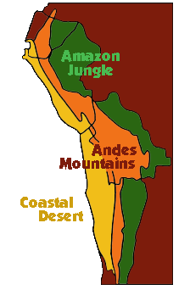
Where Did They Live?
The Incas were a small tribe of South American Indians who lived in the city of Cuzco, high in the Andes Mountains of Peru.
They grew quickly and expanded into more areas of South America.
The Incas had natural barriers in the Andes Mountains, Amazon jungle, and the coastal desert.

Slide 3
Government
The Incas had a strong central government.
Everybody worked for the state, and in turn the state looked after everybody.
The Sapa Inca was the head of the government
Everything belonged to the Sapa Inca. He ruled his people by putting his relatives in positions of power.

Slide 4
Classes
The Incas were divided into nobles and common people.
The nobles did what they wanted, while the common people had tight rules.
Commoners could not own or run businesses. They could only do their assigned jobs. Even the amount of time they could sleep and bathe was controlled by the government.
The people paid their annual taxes in physical labor—serving in the army, working in mines, or building roads and temples.

Slide 5
What work would you want to do to pay your taxes?

Slide 6
Getting Around
The Incas built bridges across the gorges in the mountains, so they could reach all parts of their empire quickly and easily.
They also built 14,000 miles of well-built roads.

Slide 7
Fall of the Incas
Francisco Pizarro held the Atahualpa (King of the Incas) hostage and then killed him.
Pizarro then took over the capital city of Cuzco and changed the name to Lima.

