Slide 1
The Mayans

Slide 2
Farming
The Mayan people began to develop around 300 CE in what is southern Mexico today.
Mayans had intensive agricultural techniques like animal power, crop rotation, and irrigation.
They built terraces to retain silt and improve production.
They grew maize, cotton, and cacao. Cacao was a precious commodity consumed mostly by nobles and even used as currency (money).

Slide 3
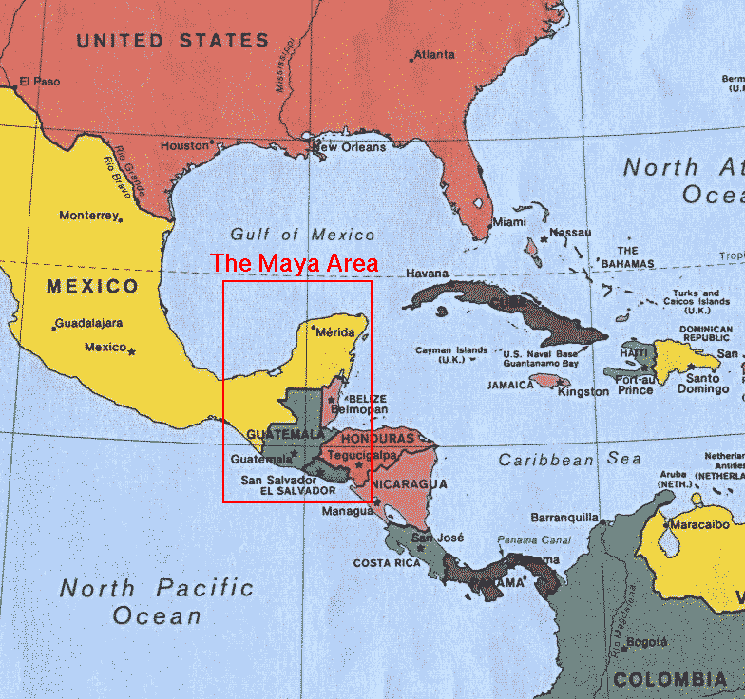

Slide 4
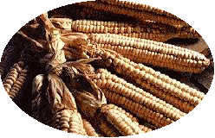
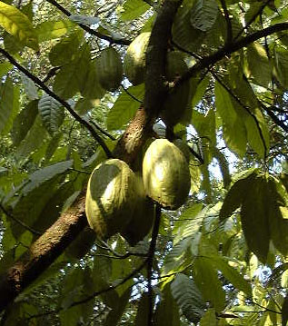
Maize Cacao

Slide 6
Social Hierarchy
King and ruling family
Priests
Hereditary nobility (later became the merchant class)
Warriors
Professionals and artisans (architects and sculptors)
Peasants
Slaves (provided labor for construction)

Slide 7
Religion
Mayans believed the shedding of human blood would prompt the gods to send rain to water the maize.
The Mayans participated in bloodletting rituals, which required a person to cut his body and release blood. The Mayan Nobles typically performed this ceremony to communicate with their gods and royal ancestors.

Slide 8
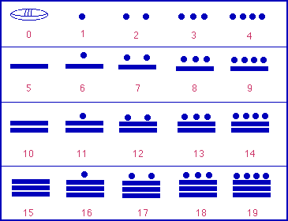
Math and Science
The Mayans could plot planetary cycles and predict eclipses of the sun and moon.
They invented the concept of zero and used a symbol to represent zero mathematically.

Slide 9
Mayan Decline
By about 800 CE, most Mayan populations had begun to desert their cities.
Possible causes include foreign invasion, civil war, agricultural disaster, epidemic diseases, and natural disasters.

