Slide 1
Eclipses and Tides

Slide 2
Eclipses
A lunar eclipse occurs when the Earth’s shadow falls on the moon.
A solar eclipse occurs when the moon passes between the Earth and the sun, blocking the sun’s light.

Slide 3
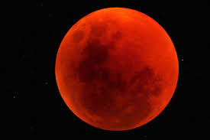
Lunar Eclipse

Slide 4
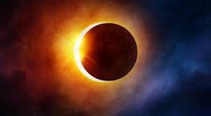
Solar Eclipse

Slide 5
Draw the sun, moon & Earth during a solar eclipse.

Slide 6
Tides
The moon’s gravity pulls on the Earth, causing tides to occur.
High tide is a bulge in the ocean when the ocean is on the same or opposite side as the moon.
Low tide occurs when the ocean is not facing or opposite the moon.

Slide 7
Draw the Earth & moon. Identify where high tides would occur.

Slide 8
Draw the Earth & moon. Identify where low tides would occur.

Slide 9
Tides
Neap tide occurs twice a month with the smallest difference between high and low tides.
Spring tide occurs during full or new moons with the highest difference between high and low tides.

